Slide 1


QSO重力レンズ多重像のフラックス異常問題に対する
視線方向のダークハローの影響について
Kaiki Taro Inoue (KINDAI)
Ryuichi Takahashi (Hirosaki U.)
カテゴリ XT4B

Slide 2
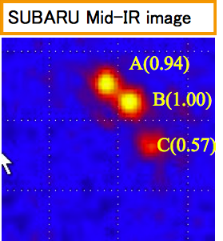
（Flux- ratio anomalies）
QSO重力レンズ多重像のフラックス異常問題
レンズの密度分布をモデル化
像の位置は説明できる
明るさの比が説明できない
(Mao & Schneider ’ 98, Metcalf & Madau‘01,
Chiba ’02, Dalal & Kochanek’02)
B1422+231 Chiba et al. ’05

Slide 3
Flux- ratio anomalies
Sub halos
QSO
galaxy

Slide 4
Flux- ratio anomalies
Sub halos
but predicted subhalos too low for anomalies
(Maccio & Mirranda 2006, Amara et al. 2006;
Xu et al. 2009, 2010; Chen 2009; Chen et al. 2011)
Luminous satellites may contribute significantly
(McKean et al. 2007, Shin & Evans 2008;
MacLeod et al. 2009)
Line-of-sight halos?
(Chen et al. 2003, Metcalf 2005, Xu et al. 2011)

Slide 5
Flux- ratio anomalies
Sub halos
QSO
galaxy

Slide 6
QSO
galaxy
Satellites
Group galaxy

Slide 7
Flux- ratio anomalies
Sub halos
but predicted subhalos too low for anomalies
(Maccio & Mirranda 2006, Amara et al. 2006;
Xu et al. 2009, 2010; Chen 2009; Chen et al. 2011)
Luminous satellites may contribute significantly
(McKean et al. 2007, Shin & Evans 2008;
MacLeod et al. 2009)
Line-of-sight halos?
(Chen et al. 2003, Metcalf 2005, Xu et al. 2011)

Slide 8
Flux- ratio anomalies
Sub halos
but predicted subhalos too low for anomalies
(Maccio & Mirranda 2006, Amara et al. 2006;
Xu et al. 2009, 2010; Chen 2009; Chen et al. 2011)
Luminous satellites may contribute significantly
(McKean et al. 2007, Shin & Evans 2008;
MacLeod et al. 2009)
Line-of-sight halos?
(Chen et al. 2003, Metcalf 2005, Xu et al. 2011)

Slide 9
Flux- ratio anomalies
QSO
galaxy
Sub halos

Slide 10
Line-of-sight halos
QSO
galaxy
Sub halos

Slide 11
先行研究1 Metcalf 2005
Line-of-sight halos は flux anomaly を説明可能
Ray-tracing simulation
Line of sight halos
・Sheth-Tormen (2002) mass function でランダム分布
・ NFW halo model with M<10^10 Msun
像の位置のずれの影響も議論

Slide 12

先行研究2 Xu+ 2012
Line-of-sight halos は sub halos と同程度に効く
Ray-tracing simulation
Line of sight halos
・Millennium simulation II (Boylan-Kolchin+ 2009) の
halo catalogue
・Sheth-Tormen (2002) mass function でランダム分布
NFW, SIS halo model with M>10^6 Msun
$$z_{L}=0.6, { z}_{S}=2$$
の場合ののみ

Slide 13
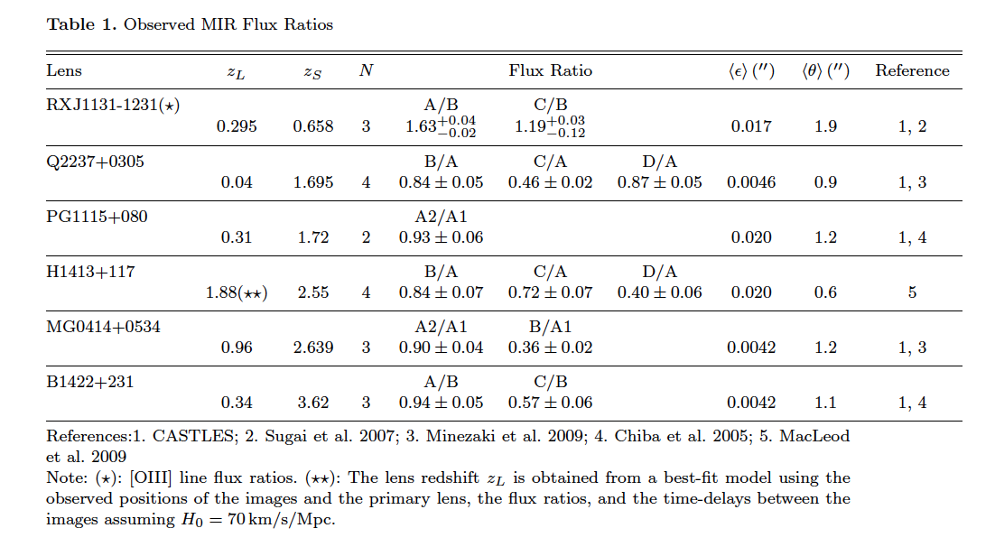
6 MIR quadruple lenses

Slide 14
Our work
Semi-analyitic estimate based on VERY high
resolution N-body simulation fully incorporating
clustering effects of M>10^5 solar mass halos
Astrometric shifts taken into account
New static rather than ‘classic’ cusp-caustic
relations
Only MIR lenses. Source sizes =O[1 pc]

Slide 15
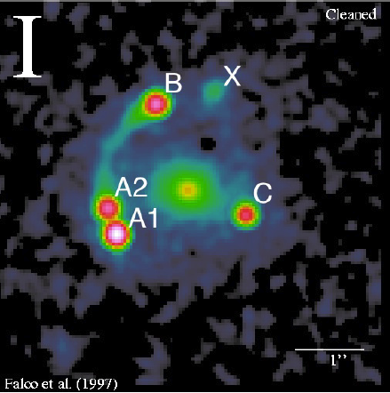
Magnification perturbation
singular isothermal elliposoid（SIE）+ external shear model で
像の位置を再現
MG0414+0534
各像での convergence $κ$, shear $γ_{1,2}$, magnification $μ$を求める

Slide 16
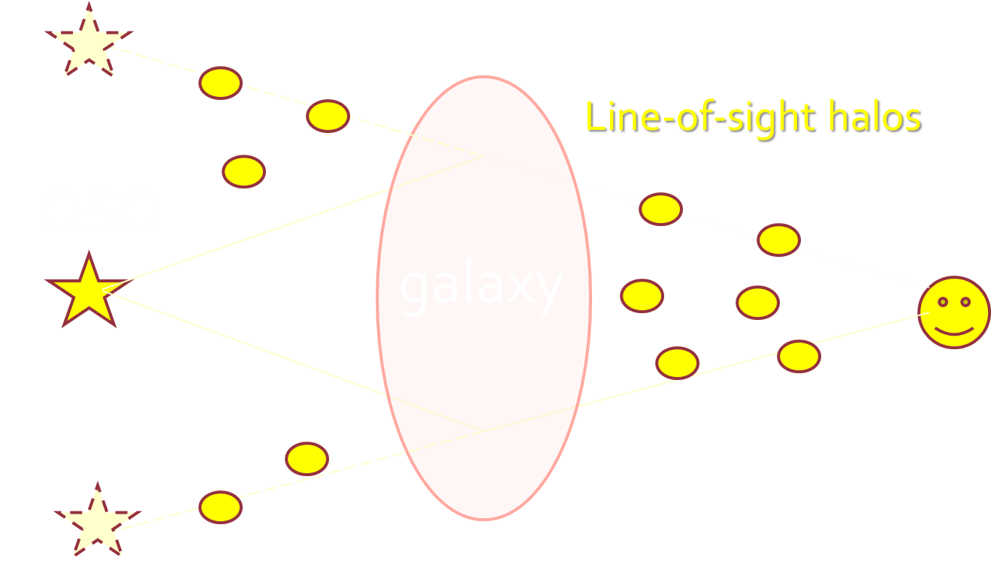



Magnification perturbation
$$δκ, {δγ}_{1,2}$$
$$δκ, {δγ}_{1,2}$$
視線方向のダークハローによる寄与を加える
$$κ→κ+δκ, {{ γ}_{1,2}→γ_{1,2}+δγ}_{1,2}$$
$$μ→μ+δμ$$

Slide 17



New statistic η
magnification contrast
$$δ^{μ}={δμ}/μ$$
η : effective magnification perturbation
A,C: minimum B:saddle
観測値
obs

Slide 18
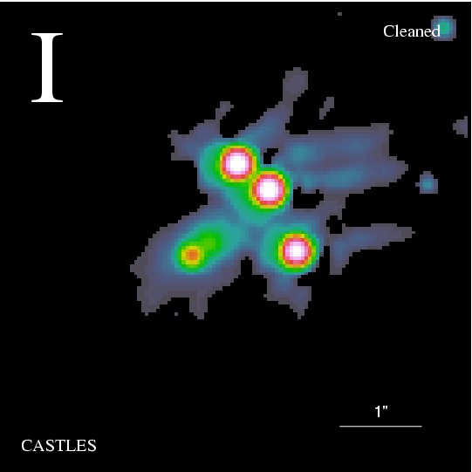

B1422+231
A
minimum
B
saddle
C
minimum

Slide 19
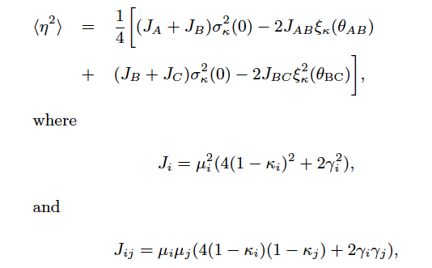
New statistic η
convergence two-point correlation function
κ: background convergence γ: background shear

Slide 20
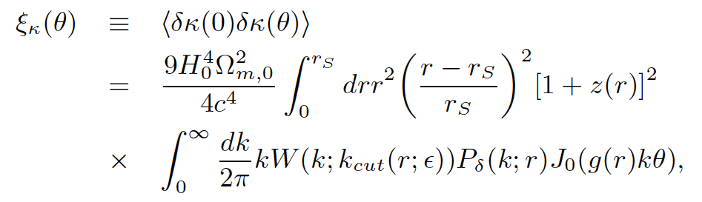
Constrained 2-point correlation
Dark matter の揺らぎの power spectrum

Slide 21


Constrained 2-point correlation
普通の２点角度相関
$$θ$$
unperturbed path
今回の２点角度相関
$$θ$$

Slide 22
MG0414+0534

Slide 23
MG0414+0534
銀河スケール（1-10kpc）の揺らぎが効く
質量 10^6-10^7 Msun

Slide 24

Astrometric shifts
Intervening halo lensing により像の相対位置をずらしてはいけない
Given by accuracy in position of centroid ε
Minimum wavenumber given by ε

Slide 25
Non-linear power spectrum

Slide 26
N-body Simulation
Two 512^3 one 1024^3 colissionless particles
simulations :baryons are not included.
Box-size=10Mpc/h code: L-Gadget2 (Springel et al.)
Plus simulations with box-size=320,800,2000Mpc/h
HITACHI SR16000 512CPUs, CPU time >3 months
Concordant LCDM (WMAP7yr+H_0+BAO)

Slide 27
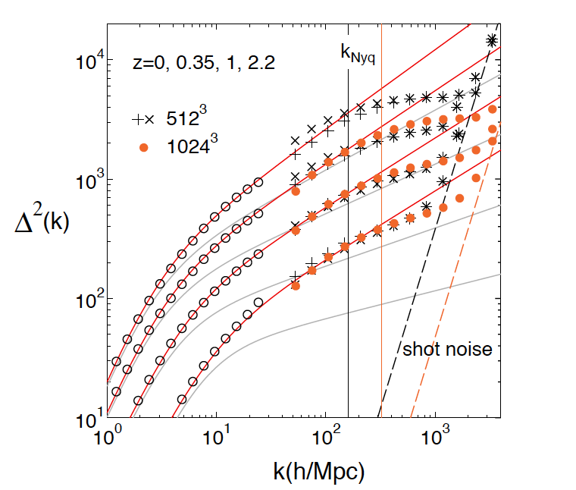
Non-linear power spectrum
Halo – fit by our work
Halo – fit by Smith et al. 2003

Slide 28
Non-linear power spectrum
Halo – fit by our work
Halo – fit by Smith et al. 2003

Slide 29
Application to MIR lenses

Slide 30
MIR QSO-galaxy quads
6 samples:5 continuum 1 line [OIII]
SIE-ES model possibly with SIS for a luminous
satellite (gravlens by Keeton)
Astrometric shifts given by position errors
(CASTLES) in lensed images and lens & size of
critical curves -> minimum wavelength.

Slide 31
MIR quadruple lenses

Slide 32
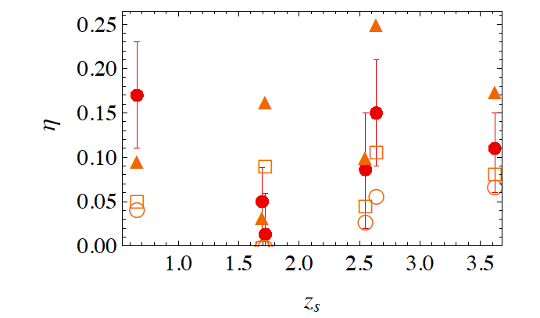
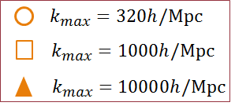


Result I
$$k_{max}=1000h/Mpc$$
$$k_{max}=10000h/Mpc$$
observation
source redshift

Slide 33
Summary
Clustering line-of-sight halos with M=10^3-7 solar mass can explain the observed anomalous flux ratios without any substructures inside a lensing galaxy.
The estimated amplitudes of convergence perturbation increase with the source redshift as predicted by theoretical models.
Unique probe into mini-halos M<10^6 solar mass

Slide 34
Summary
手間のかかる ray-tracing 計算を行わなくても、weak lensing 業界でおなじみの convergence power spectrum を使えば、誰でも手軽に flux anomaly を計算できる

Slide 35
Future Work
Main lens 内の substructure も考慮
バリオン成分の影響
（小ハロー M<10^6Msun はバリオンクーリングが効かない
ため、ダークマターが主成分と期待される。超新星爆発
でガスが吹き飛ばされるため。）
small scale での P(k) への制限
warm dark matter ? （Mirranda & Maccio 2007）
ALMA でレンズ天体の詳細観測

Slide 36
Fitting function of non-linear matter power spectrum
Halo-fit model our model
～30% discrepancy <10% agreement
● ● ：simulation results

Slide 37
w=-0.8 w=-1.2

Slide 38
Fitting function of non-linear matter power spectrum
Halo-fit model our model
～30% discrepancy <10% agreement
Cosmic shear, convergence power spectrum & correlation function

Slide 39
Fitting function of non-linear matter power spectrum
Halo-fit model our model
～30% discrepancy <10% agreement
Cosmic shear, convergence power spectrum & correlation function
10% up

Slide 40
Fitting function of non-linear matter power spectrum
Halo-fit model our model
～30% discrepancy <10% agreement
Cosmic shear, convergence power spectrum & correlation function
RT, Sato, Nishimichi, Taruya, Oguri, 2012, ApJ in press
計算コードは CAMB に標準搭載
10% up

Slide 41
XT4 を用いた今年度の成果
・QSOの重力レンズ多重像の明るさの異常問題に対する
視線方向のハローの寄与 with 井上開輝さん（近畿大）
Inoue & RT 2012, RT & Inoue in preparation
・宇宙大規模構造のダークマター揺らぎの非線形パワー
スペクトル with 佐藤君（名大）、樽家さん（東大）
西道君、大栗君（東大IPMU）
RT, Sato, Nishimichi, Taurya, Oguri 2012
・重力レンズを受けた宇宙背景輻射の温度偏光ゆらぎ
with 並河君（東大）、D. Hansonさん（カルテク）
Namikawa, Hanson, RT submitted to MNRAS

Slide 42
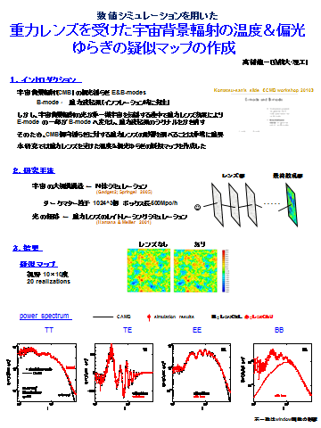

Slide 45
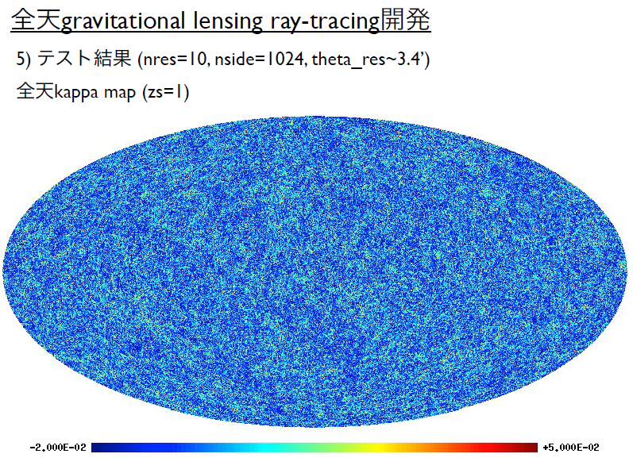
HSC用全天ray-tracing simulation 浜名さん、白埼君、吉田さん、、、

Slide 46

Future work
Consistency check using light-ray tracing simulations
(N(>2)-point correlation effects, etc.)
Minimum change in astrometric shift for lensed
image & lens.
Check of SIE+ES, luminous group/satellite galaxies
Extention to radio lenses incorporating finite source-
size effects

Slide 48
Outline
Introduction (flux ratio anomalies)
Magnification perturbation
Non-linear power spectrum
Application to MIR lenses
Summary
Future work

Slide 49
Introduction

Slide 50
Suppression Mechanism
Baryon physics (reionization, tidal disruption
due to disk, SNe feedback)
New physics (warm dark matter, self-interacting
DMs, super WIMPs, non-trivial inflaton dynamics )
Need to probe clustering property of halos
with M<10^9 solar mass

Slide 51
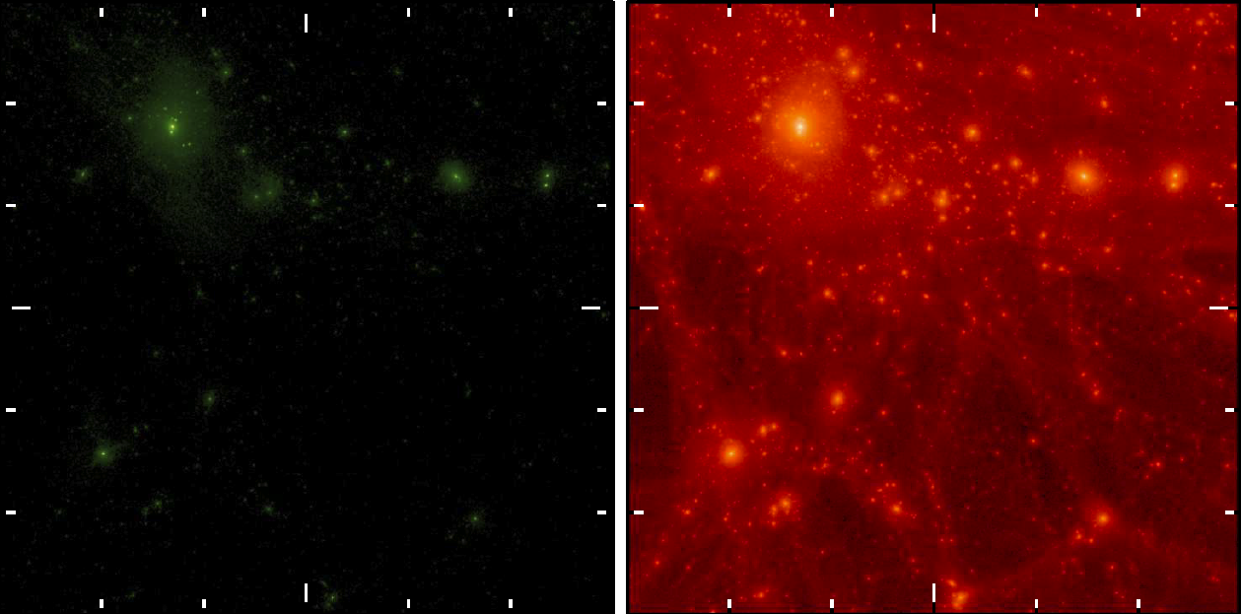
11.2 Mpc
Simulation by Sawara et al .2012

Slide 52
Sub halos
QSO
ETG

Slide 53
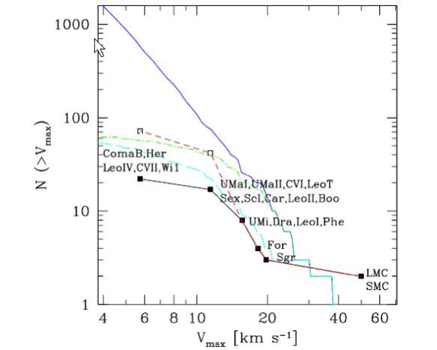





Missing Satellite Problem
M<10^9 solar mass

Slide 54
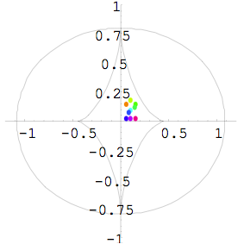
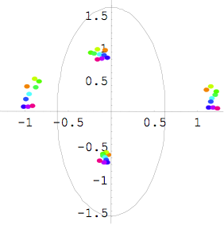


Parity of lensed images

Slide 55
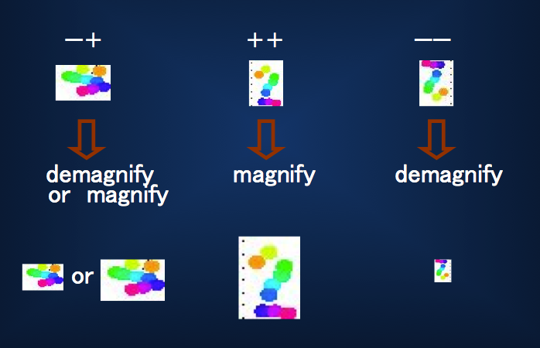
Systematic (de)magnification
（Δκ＞０）

Slide 56
QSO
galaxy

Slide 57
MG0414+0534

Slide 58
MG0414+0534
minimum
saddle
saddle
minimum

Slide 59
MG0414+0534
2ε

Slide 60
MG0414+0534

Slide 61
MIR quadruple lenses

Slide 62
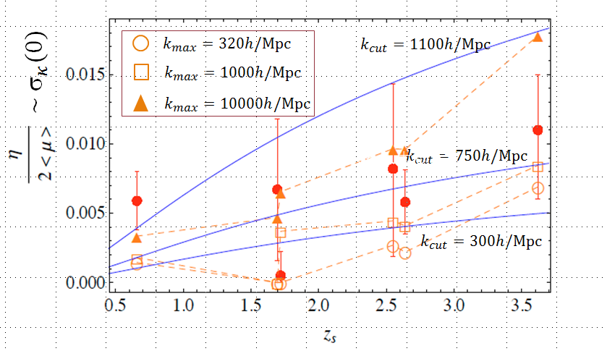
Result II

Slide 63
MG0414+0534

Slide 64
MG0414+0534
minimum
saddle
saddle
minimum

Slide 65
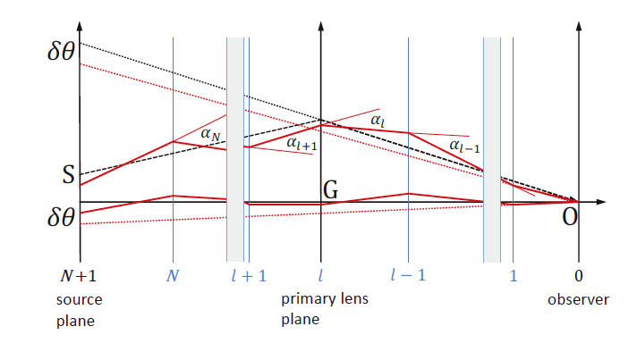
Astrometric shifts

Slide 66

Astrometric shifts
2-point correlation in shift of image separated by θ
Given by power spectrum P(k)

Slide 67
Astrometric shifts
Minimum wavenumber given by
the size of Einstein radius

Slide 68
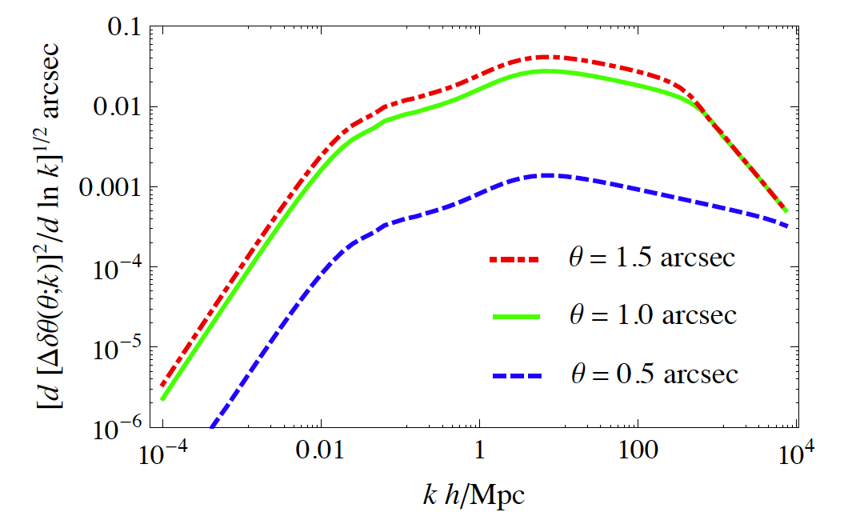
Astrometric shifts

Slide 69
Astrometric shifts
Super
cluster
cluster
galaxy
satellite
Mini-halo
External shear
SIE, SIS
Pertur
-bation

Slide 70
Constrained convergence power
Accuracy in position of lensed images & lens
Size of Einstein ring

Slide 71
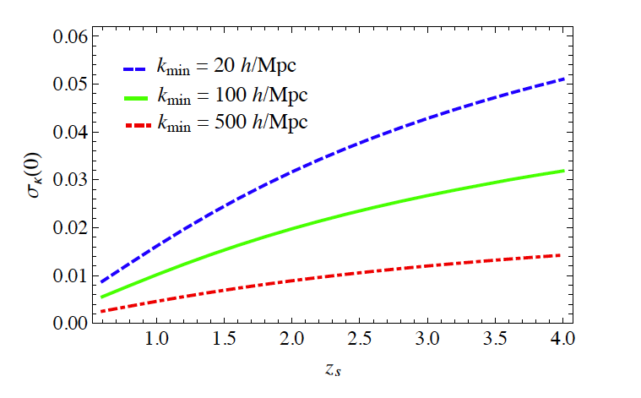

Constrained r.m.s. convergence

Slide 72
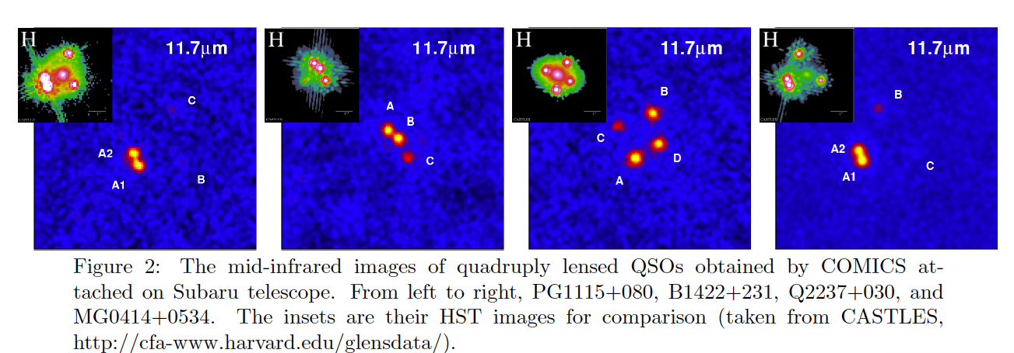
MIR quadruple lenses
Source size estimated from dust reverberation method ~ 1~3pc >>Einstein radius of stars
(by Chiba et al 2005 & Minezaki et al. 2009)

