Slide 1

General relativistic simulation of black hole - neutron star binary mergers
Kenta Kiuchi (YITP)
Collaboration with Koutarou Kyutoku、 Yuichiro Sekiguchi、Masaru Shibata
Notes:
Today, I’m gonna talk about numerical relativity simulations of compact binary merger, composed of black hole and neutron star.
I am Kenta Kiuchi from YITP and these people are my collaborators and this work is supported by the HPCI program in Japan.

Slide 2
Introduction
▶Direct observation of G.W. within 5 – 10 years
▶ Coalescence of compact binaries composed of NS or BH : Primarily target of KAGRA, adv. LIGO, adv. VIRGO
▶What BH-NS, NS-NS mergers tell us ?
▶Verification of GR in strong gravitational field
▶The equation of state of high density matter（G.W. ⇒ Mass and radius of NS ⇒ Reconstruction of M-R relation）
▶ Central engine of short-hard gamma-ray burst (Narayan+92)
▶Importance of electromagnetic counter part
Scenario 1：Mass ejection in merger process ⇒ synchrotron radiation（radio）(Nakar & Piran 11)
Scenario 2：Radioactive decay of r-process element (infrared-optical）(Li-Paczynski 98, Metzger+10, 12)
We should verify the properties of ejected element ;
mass and velocity
Notes:
First of all, let me give a brief introduction. As Sekiguchi san introduced in the previous talk, the main motivation of this research is
gravitational waves because Japanese gravitational wave detector KAGRA, advanced LIGO in USA, and advanced VIRGO in Italy will
start observations within a few years and coalescence of compact binaries is one of the most promising source of gravitational waves.
So, if you detected gravitational waves from these sources, they could tell us the validity of the general relativity in strong
gravitational fields, the equation of state of high density matter, and they may give information of the central engine of short-hard gamma-ray burst.
Motivated by these facts, people in this research area seriously consider what the electromagnetic counter part of compact binary merger is.
The scenario proposed by Nakar and Piran is that the ejected matter in the merger process interacts with the inter-stellar matter, then electro magnetic signal is emitted by the synchrotron radiation. The other one is a radioactive decay of r process element in ejected material.
To assess these scenarios, we should verify the properties of ejected matter such as mass and velocity.

Slide 3
Overview of BH-NS binary merger
Tidal disruption or not ?
BH
NS
BH-disk
Tidal disruption
NS (M_{NS})
Tidal force > Self-gravity of NS
⇒ r ≾ (M_{BH}/M_{NS})^{-2/3} (M_{NS}/R_{NS})⁻¹ M_{BH} ≡r_{tidal}
If r_{tidal} > r_{isco} ⇒ Tidal disruption
r_{tidal} < r_{isco} ⇒ No tidal disruption
Key ingredients
▶ Mass ratio q≡M_{BH}/M_{NS}
▶ Compactness C≡M_{NS}/R_{NS}
▶ BH spin a (a↗⇒ r_{ISCO}↘)
BH (M_{BH})
R_{NS}
r
Notes:
This is an overview of black hole-neutron star merger. If the separation between the two is large enough, they are
nicely approximated as a point particle. Then, a finite size effect enters the game.
Because the back hole originally exists in this system, the finale state is the black hole surrounded by a torus. The point is whether
the tidal disruption does occur or not during the merger process. This is a schematic picture of a tidal disruption and a fluid element on the surface of
the neutron star as well as the neutron star itself are dragged by the black hole. Because of the finite size of the neutron star, there is a difference
in the acceleration between the surface fluid element and one in the stellar center. This is a tidal force. In addition, the neutron star itself has a self gravity.
So, if this inequality holds the tidal force overcomes the neutron star self-gravity and we call the right hand side quantity a tidal radius.
If the tidal radius is larger than the inner stable circular orbit radius, the tidal disruption occurs. Otherwise, it doesn’t.
The key ingredients of tidal disruption in black hole-neutron star system are mass ratio, compactness of neutron star and black hole spin.
Increasing the mass ratio or compactness of the neutron star, the system is less subject to the tidal disruption. The spin of black hole enhances the chance of the tidal disruption because of the shrink of the isco radius.

Slide 4
Current status of BH-NS merger GR simulations
▶ YITP (Japan)
- Γ-law EOS without BH spin (Shibata-Uryu 06,07, Shibata-Taniguchi 08)
- Nuclear theory based T=0 EOS with/without (aligned) BH spin (Shibata +09, Kyutoku+10, Kyutoku+ 11)
▶ Illinois University (USA)
- Γ-law EOS with/without BH spin (Etienne+ 08,09)
- Γ-law EOS with B-field (Etienne+ 11,12)
▶ Louisiana University+ (USA)
Γ-law with B-field (Chawla+ 10)
▶ Caltech-Cornell University (USA)
Γ-law with/without (tilted) BH spin (Duez+ 08, Foucart+11)
T≠0 EOS without neutrino cooling (Duez+ 10)
BH-NS merger simulations implementing T≠0 EOS and neutrino cooling are mandatory.
Notes:
This is a current status of black-hole neutron star merger simulations in numerical relativity. In Kyoto group, the work done by the Shibata-Uryu is a first numerical relativity simulation of black hole-neutron star merger in which the Gamma-law equation of state was used and black hole didn’t have a spin. Kyotoku has done a systematic study in which neutron stars are modeled by the nuclear theory based zero temperature equation of states and black holes have an aligned spin to the orbital angular momentum.
The Illinois group did the simulations with Gamma-law equation of state and black hole spin or with the magnetic field. Louisiana University group implemented the magnetohydrodynamics in their code and Caltech-Cornell University group recently simulated the tilted black hole spin models. They simulated the finite temperature equation of state models as well in which the neutrino cooling was neglected.
Today, I would like to introduce our latest simulation of black-hole neutron star merger in which both the finite-temperature equation of state and neutrino cooling are implemented.

Slide 5
Set up
Code description (Talk by Sekiguchi)
▶ Einstein solver (BSSN-puncture) (Shibata-Nakamura 95, Baumgarte-Shapiro 99, Campanelli + 06, Baker + 06 )
▶ GR hydro. + neutrino cooling (GR-leakage) (Sekiguchi 10)
▶ Fixed-mesh refinement (Yamamoto+ 08)
Model
▶ Shen EOS (Shen+ 98)
▶ M_{NS} = 1.35 M☉(C≈0.133)
▶ M_{BH}/M_{NS} = 3
▶ BH spin : a = 0, 0.5
Notes:
This is a short summary of our code. The Einstein equations are solved with the Baumgarte-Shapiro-Shibata-Nakamura-puncture formulation
and hydrodynamics as well as the neutrino transfer are solved with the method developed by Sekiguchi san.
We implement the fixed-mesh refinement technique to resolve black hole, neutron-star and gravitational waves simultaneously.
The neutron star is modeled with the Shen equation of state with one point thirty five solar mass, whose compactness is point one three three.
We fix the mass ratio of black hole to neutron star three and do simulations with spinning black hole and nonspining black hole.

Slide 6
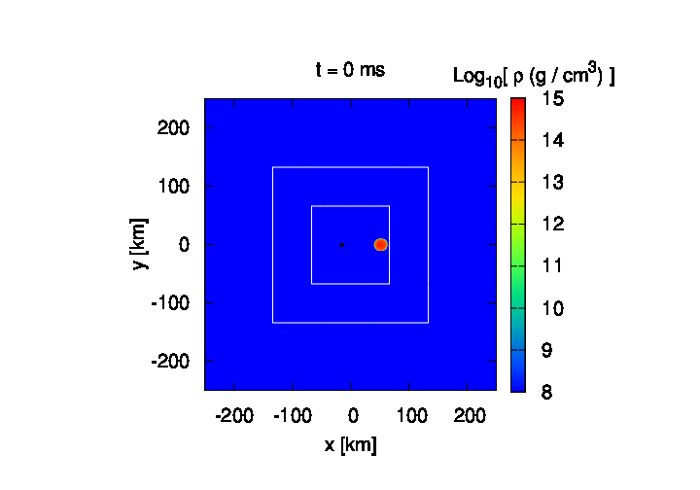
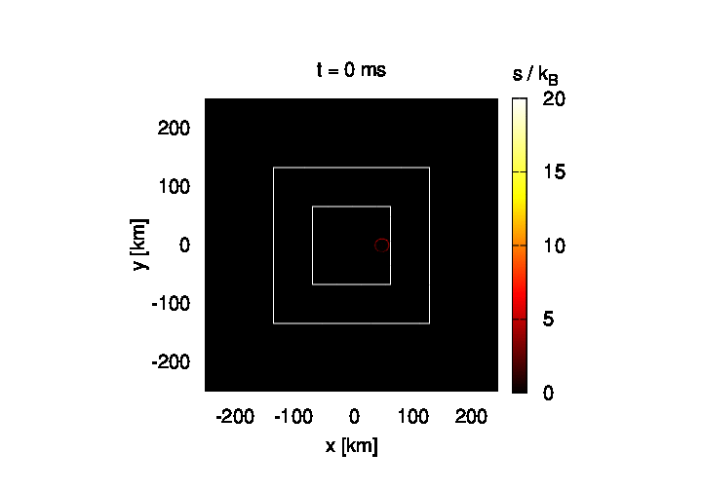
Result
a = 0.5（Orbital plane）
Density
Entropy / baryon
▶Tidal disruption
▶Formation of massive and hot disk (ρ_{max}∼10¹¹⁻¹²g/cc, T_{max} ∼10 MeV)
Notes:
This is a result of numerical simulation of the spinning model and these animations show a density and entropy contour on the orbital plane.
After staring the simulation, the separation between the two gradually decreases due to the radiation reaction. Then, you can see the tidal disruption occurs. The tidally disrupted neutron star forms a massive and hot accretion disk around the black hole. Typical density and temperature are
ten to the eleven or twelve gram per cubic centimeter and ten mev.

Slide 7

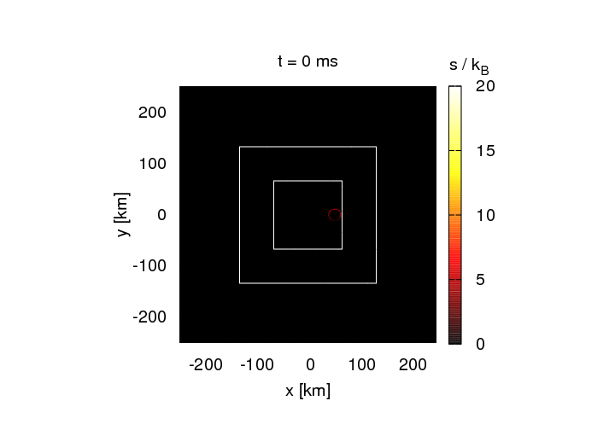
Result
a = 0.0（Orbital plane）
Density
Entropy / baryon
▶Spin-orbital coupling（repulsive force if positive spin）⇒Longer inspiral phase
▶Spin model ⇒ Massive disk (r_{isco}↘)
Notes:
What about the nonspinning case ? These are same animations as the previous slide, but for the nonspinning model.
You can see the duration of inspiral phase is shorter than the spinning model because of the absence of the spin-orbit coupling.
This coupling causes a repulsive force in the positive spin case and extend the inspiral phase as a result.
At the same time, the spinning model produces more massive disk than the non-spinning case because of the shrink of the isco radius.

Slide 8
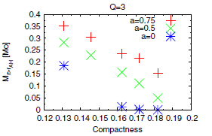
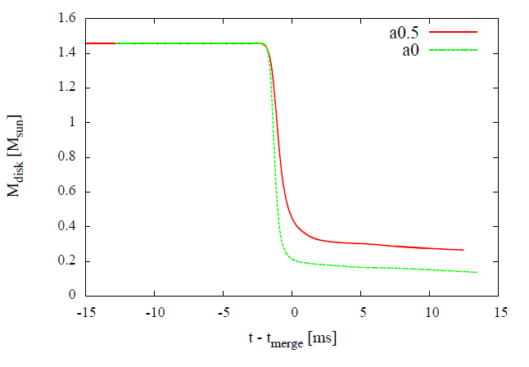
Result
Comparison with the previous work (Kyutoku+11)
Evolution of disk mass
Spin
No-spin
▶Spin model ⇒ Smaller r_{ISCO} ⇒ More massive disk
▶Kyutoku+11⇒Systematic survey with Piece-wise Polytrope EOS
▶Good agreement with the mass – compactness relation
Notes:
Let me check the evolution of disk mass. This plot is an evolution of disk mass in both the spinning and non-spinning model
and you can see the more massive disk is produced in the spinning case as I said before. The reason is that the isco radius shrinks with increasing the spin,
which implies the material has more chance to escape from the capture by the black hole because the duration of the angular momentum transfer takes longer. Next point is how reasonable these figures are in comparison to the previous work,
This plot is a disk mass as a function of compactness of neutron star in the paper by Kutoku et al. They did a systematic study on black hole – neutron star merger, in which the neutron star is modeled with a piece-wise polytrope EOS mimicking the nuclear theory based equation of state.
The color code means the spin of black hole. These filled circles are the result in our simulation and you can see a good agreement with the
previous work.

Slide 9
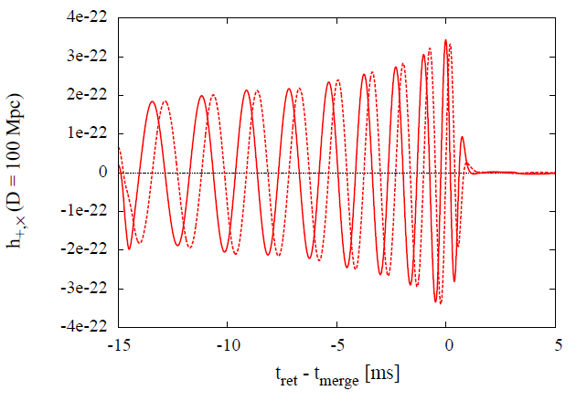
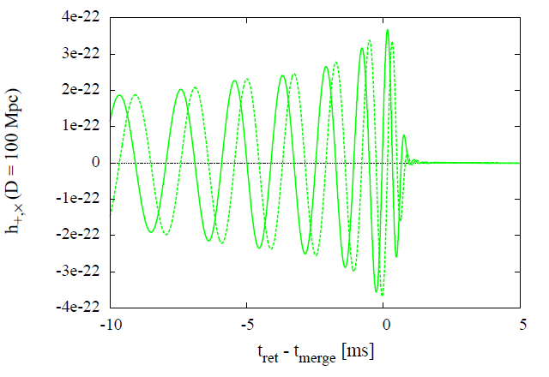
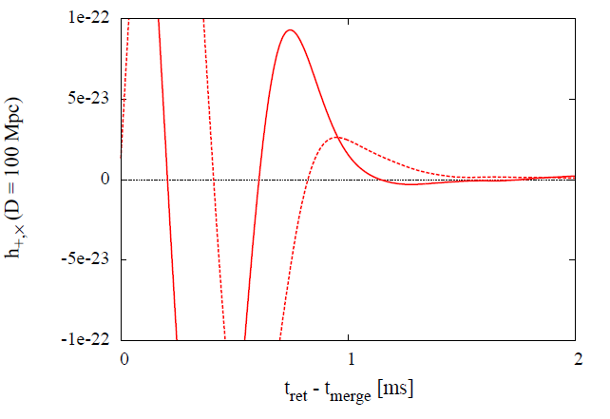
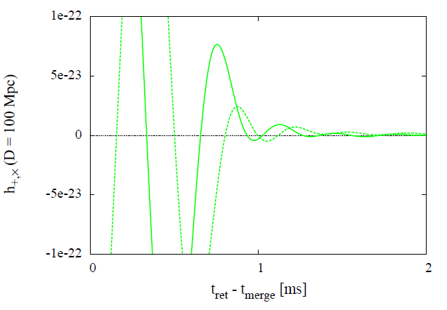
Result
Gravitational waves
Spin
No-spin
Quasi normal mode of BH
Sudden shut down of GW
⇒ Tidal disruption
Notes:
Let’s move on to the gravitational waves. These plots are waveforms for the spinning model and non-spinning model. The sin-curve like waveforms indicates an inspiral phase and you can see the sudden shutdown in the waveforms, which implies that the tidal disruption occurs at this moment. If you look at the waveform just after the tidal disruption, you can find a ringing in
the non-spinning model. This is a quasi normal mode of black hole. The ringing is hard to see in the spinning model.

Slide 10
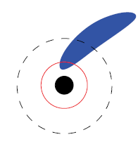
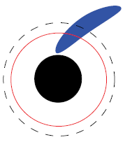
Result
Why is the BH-QNM excited in the no-spin case ?
Spin
No-spin
Caution：
Fixed mass ratio
NS
BH
r_{tidal}
r_{ISCO}
Courtesy to Kyutoku
▶Spin→ Formation of axisymmetric disk→Surppression of QNM
▶No-spin→ Coherent accretion →Excitation of QNM
Notes:
This schematic picture explains why the quasi normal mode is excited in the non-spinning case and is not in the spinning case.
Note that in this explanation the mass ratio is fixed. This is a black hole and this is a neutron star tidally elongated.
The black dashed circle is the tidal radius where the tidal disruption occurs and the red curve is the isco radius.
In the spinning model, the separation between the tidal radius and the isco radius is wider than the non-spinning model.
So, the disk formed after the tidal disruption is nearly axisymmetric, which suppresses the quasi normal mode.
On the other hand, in the non-spinning model, the tidally disrupted neutron star starts to accrete on the black hole just after the tidal disruption,
implying that it accretes in a coherent way and excites the quasi normal mode as a result.

Slide 11
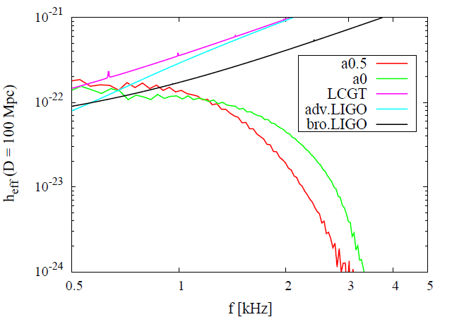
Result
GW Spectra
Spin
→Extension of inspiral
Non-spin
→Excitation of QNM
Notes:
This is gravitational wave spectra. As I explained several times, the black hole spin makes the inspiral phase long and the amplitude goes up
compared to the non-spinning case. The quasi normal mode is exited in the non-spinning case and it pushes the spectrum to the high frequency side.

Slide 12
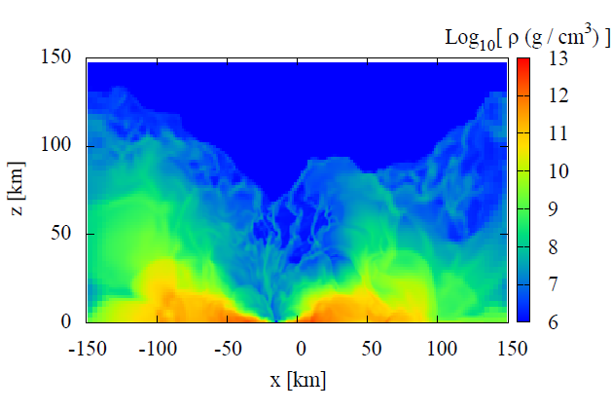
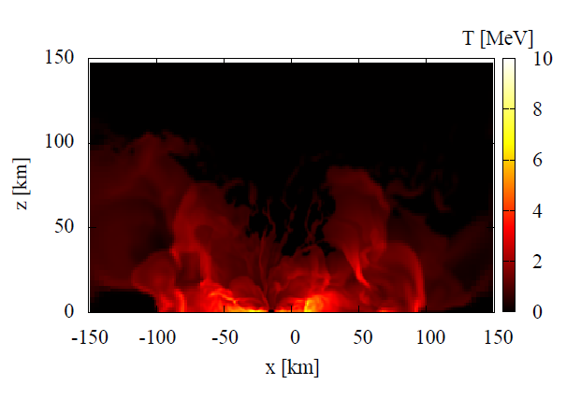
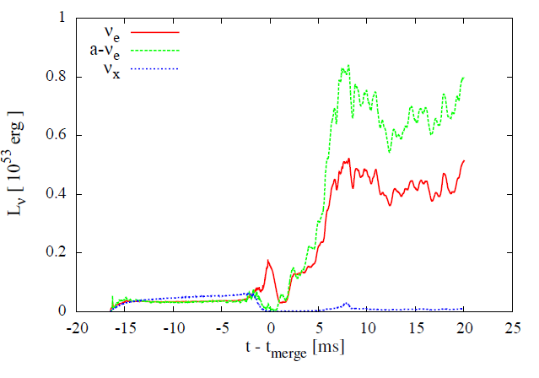
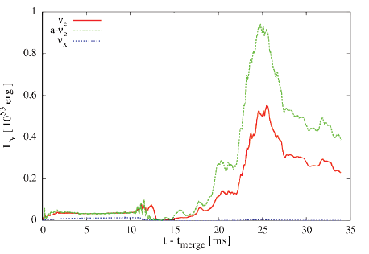
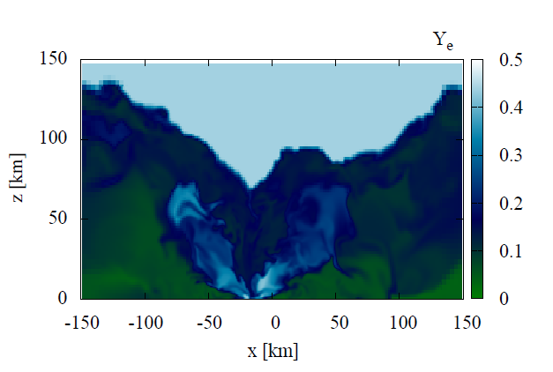
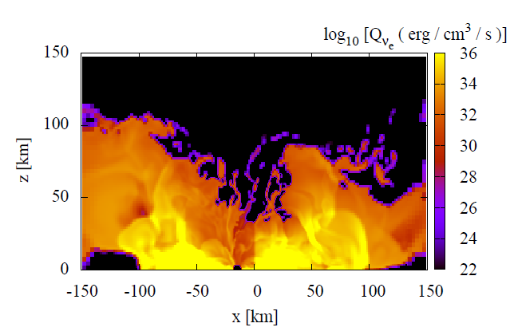
Result
Neutrino luminosity curve
Spinless
Spin
anti-electron neutrino
electron-neutrino
μ,τ-neutrino
▶Hierarchy of neutrino luminosity ν_{e} >ν _{e} > ν_{x}
→ Hot disk ：γγ→ e⁺ + e⁻
△ p+ e⁻ → n + ν_{e}
○ n+ e⁺ → p + ν_{e}
▶ t_{vis} = α⁻¹(H / r) ⁻² Ω⁻¹ ∼ O(100) ms (α/ 0.1)⁻¹
Notes:
This is a neutrino luminosity curve and you can see the luminosity enhances after the merger implying the neutrino is mainly emitted from the accretion disk formed by the tidal disruption. The hierarchy of the neutrino luminosity is anti-electron neutrino, electron neutrino, and the x neutrino. Because the temperature inside the disk is
quite hot, the thermal photon produces an electron-positron pair efficiently. In addition, the neutron star is mainly composed of the neutron, as you know,
this reaction proceeds preferentially than this reaction and produces anti-electron neutrinos efficiently.
These are snapshots of the physical quantities of the disk and we calculated the viscosity timescale. This high-amplitude neutrino luminosity
is expected to continue for several hundred milliseconds.

Slide 13
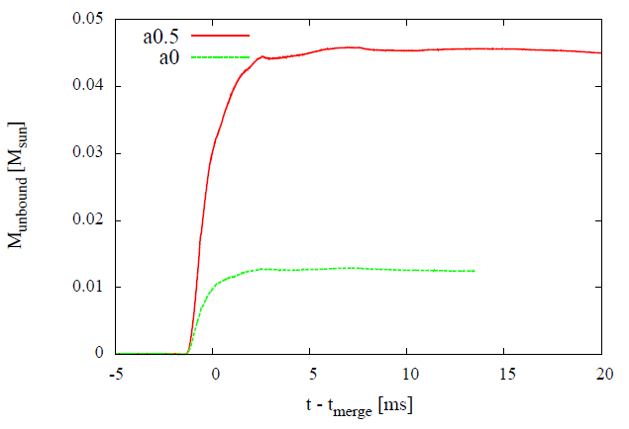
Result
Ejected mass（∫_{ut<-1}ρ*dV）
Spin
No-spin
‣ Synchrotron radiation (Nakar & Piran 11)
∼ 90μJy (E₀/10⁵⁰erg)(n₀/1cm⁻³)^{0.9}(v/0.3c)^{-2.8} (D/200Mpc)⁻² (ν_{obs}/1.4 GHz) ^{-0.75}
‣r-process element (Li-Paczynski 98, Metzger+10, 12)
t_{peak} ∼ 0.24 day (v/0.3c)^{-1/2} (M_{eje}/10⁻² M )^{1/2}
L_{peak} ∼ 2.6 ×10⁴² erg/s (f/3×10⁻⁶) (v/0.3c)^{1/2} (M_{eje}/10⁻² M )^{1/2}
Could be detected with future-planed radio or infrared-optical detectors
Notes:
Finally, let me show the mass ejection. As I showed you in the animation, the massive disk is formed due to the tidal disruption.
This mechanism and shock heating drives the mass ejection. This is a plot of the evolution of ejected mass and typically point o one or four solar mass is
ejected from the black hole – neutron star merger. Typical velocity is sever ten percents of the speed of light and you can get the flux, duration
and luminosity in both scenarios for the electromagnetic radiation. These numbers suggest that these events could be detected
by the current or future-planed detectors.

Slide 14
Summary
▶ Numerical relativity BH-NS simulation implementing T ≠ 0 EOS and neutrino cooling
▶ NS:1.35M☉－BH: spin ／zero spin
▶ spin／zero spin→Tidal disruption
Inspiral phase ：positive spin model → Extension due to the spin-orbit coupling
GW：zero spin model→ Excitation of QNM
neutrino：luminosity 10⁵²⁻⁵³ erg/s from the accretion disk
after the merger
（anti-electron neutrino＞electron neutrino＞ μ,τ-neutrino）
Future issues
▶ r-process calculation as post-process
▶Systematic study
Notes:
Let me summarize my talk. We performed numerical relativity simulations of black hole – neutron star merger implementing a
finite temperature equation of state as well as the neutrino cooling. We investigate the spinning and non-spinning black hole case and
found that the inspiral phase is extended due to the spin-orbit coupling. In the non-spinning model, the quasi-normal mode is excited in
gravitational waves and luminosity of neutrino is ten to fifty two or three erg pre second emitted from the accretion disk after the merger.
This is future issues to be investigated and thank you for your attention.

Slide 15
q, C, と aの依存性
r_{tidal} / M_{BH} ∼ q^{-2/3} C⁻¹
▶質量比：q ↗ ⇒ 潮汐破壊は起こりにくい
良テスト粒子近似⇔有限サイズの効果小
▶ コンパクトネス：C ↗ ⇒ 潮汐破壊は起こりにくい
中性子星密度場の略図
ρ
柔らかいEOS（C大）
固いEOS（C小）
R_{NS}
R_{NS}
Notes:
Let me briefly explain the dependence of the mass ratio, compactness and spin of black hole on the tidal radius.
Increasing the mass ratio corresponds decreasing the tidal radius, which implies a suppression of tidal disruption.
Because increasing the mass ratio means that a point particle approximation of neutron star works well, it means a less finite size effect.
For the compactness, if you have a large compactness, it implies a suppression of tidal disruption. This is a schematic picture of density profile of NS and
as I explained in the previous slide, a large compactness means that the neutron star has a soft equation of state and density profile is given like this.
On the other hand, the profile for less compact neutron star is given like this. From this schematic picture, you can imagine the compact
neutron star is less subject to the tidal disruption.

Slide 16
q, C, と aの依存性（続き）
▶ BH spin：a ↗ ⇒潮汐破壊を起こしやすい
BH (M_{BH}, a=0)
BH (M_{BH}, a>0)
r_{ISCO}
r_{tidal}
r_{ISCO}
r_{tidal}
潮汐破壊なし
潮汐破壊あり
Notes:
Final ingredient is a spin of black hole. Note that the spin does not enter the tidal radius itself, but the large black hole spin increase a chance of
tidal disruption. This is intuitively explained in these two figures. Let me consider a case that the black hole doesn’t have a spin and
tidal radius is smaller than the isco radius. In such a case, the tidal disruption doesn’t happen. However, if the black hole has a positive spin,
the isco radius shrinks and it can be smaller than the tidal radius. In this case, the tidal disruption activates.
In this way, you can forecast the tidal disruption in black hole-neutron star merger qualitatively. But, in reality, the tidal disruption condition depends on the
specific model because we ignore the detailed density structure and pressure effect in deriving the condition.
So, it is mandatory to do numerical relativity simulations.

