Slide 1
Formation of Massive Cores
Induced by Cloud-cloud Collision
Tsuyoshi Inoue
Aoyama Gakuin Univ.
Collaborators: Y. Fukui + Nagoya Univ. Group

Slide 2
今年度の成果/進行中の研究
XT4 を使用して得られた成果/進行中の研究
3D MHD with 輻射加熱/冷却、化学進化、熱伝導
Inoue & Inutsuka 2012, ApJ, 759, 35; 自己重力版も現在まとめ中
因果的磁気抵抗を含めた2次元特殊相対論的MHD による
電磁優勢プラズマのエネルギー開放（パルサー風、ガンマ線バースト）
シナリオ: Inoue 2012, ApJ, 760, 43
2D simulation: Takamoto, Inoue & Inutsuka 2012, ApJ, 755, 76
3D simulation: Takamoto & Inoue 2013 in prep.
分子雲-分子雲衝突による大質量星コア形成の 3D MHD simulation with 自己重力
今日のテーマ: Inoue, Fukui+ 2013 in prep.
超新星残骸の 3D MHD simulation
動径分布したシンクロトロン偏光の起源:
Inoue, Shimoda, Ohira & Yamazaki 2013 in prep.

Slide 3
Isothermal MHD Shock
Cloud-cloud collision scenario is characterized by large collision velocity > 10 km/s
~
→ High Mach number shock is inevitably induced and expected to play crucial role.
According to the isothermal MHD shock jump condition:
subscript 0: preshock, 1: postshock
if ,
Sonic Mach number:
if ,
Alfven Mach number:
→ The effect of magnetic field on the shock jump is almost always important!

Slide 4
Richtmyer-Meshkov Instability
Molecular clouds are characterized by supersonic turbulence.
→ clouds are expected to be inhomogeneous due to turbulent mixing/compression.
What happens when shock sweeps fluctuating density field?
Dynamics of a shocked dense blob in molecular cloud:
shock
shock
shock
1
v_{sh}
2
3
dense blob
y
x
B
B
B
oblique shock

Slide 5
Richtmyer-Meshkov Instability
Molecular clouds are characterized by supersonic turbulence.
→ clouds are expected to be inhomogeneous due to turbulent mixing/compression.
What happens when shock sweeps fluctuating density field?
Dynamics of a shocked dense blob in molecular cloud:
shock
shock
shock
1
v_{sh}
2
3
dense blob
y
x
B
B
B
1
v_{sh}
2
3
dense blob
z
x
B
B
B
→ Shocked dense blob becomes filament that is perpendicular to B field.

Slide 6
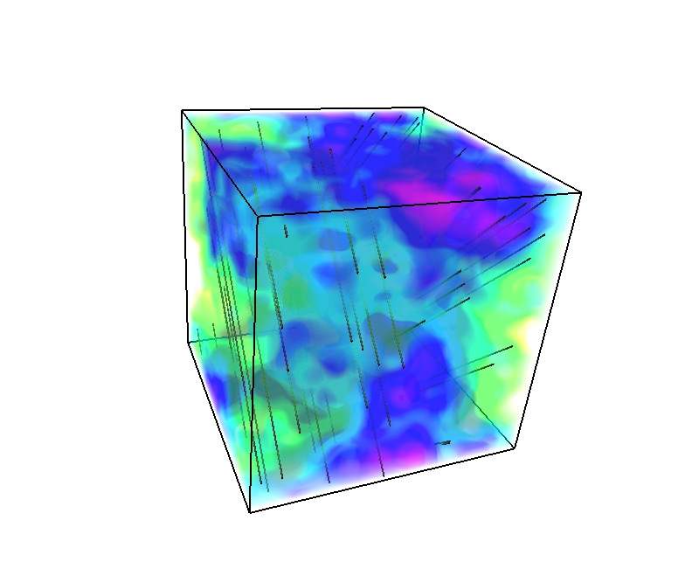

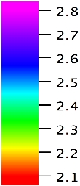
Setting of Simulation
Isothermal ( c_{s} = 0.2 km/s ) 3D MHD simulation in 3D box with self-gravity.
Fiducial setting
〈n〉=300 cm⁻³ + fluctuations with P_{log n}(k) ∝ k⁻⁴, Δn /〈n〉 = 0.43
↑ typical density spectrum in supersonic MHD turbulence (Beresnyak+05)
Converging flows along x-axis with v_{coll} = 10 km/s, which collide head on at center.
B = 20 μG in y-z plane
Volume = (8 pc)³
Resolution: Δx = 8 pc/512
= 0.015 pc
v_{flow}
v_{flow}
x

Slide 7
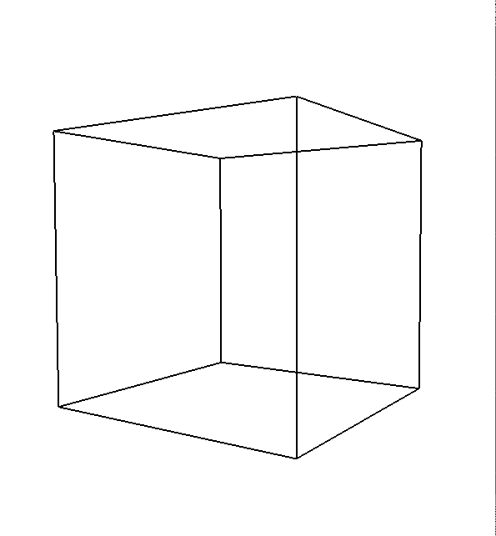
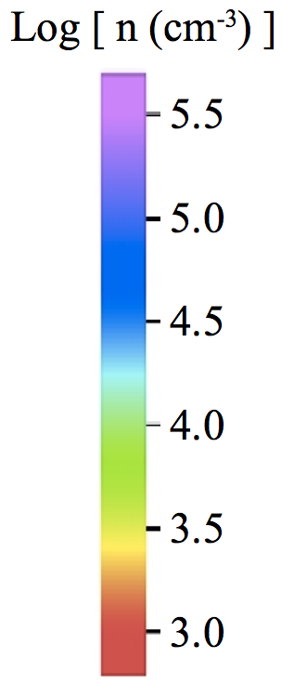
Result
Result of fiducial model
3D structure of number density
Only shocked dense gas (n > 10³ cm⁻³) is shown.
Complex of filaments are formed as expected.

Slide 8
Result
Result of fiducial model
Column density with self-gravity
Column density w/o self-gravity
Log [ N (cm⁻²) ]
Log [ N (cm⁻²) ]
z [ pc ]
z [ pc ]
y [ pc ]
y [ pc ]
Filamentary structures are formed even w/o self-gravity.
Gravity seems to make thickness of filaments uniform (~ 0.1 pc).
→ Similar to Herschel filaments (Arzoumanian+11)?

Slide 9
Mass of Contracting Cores
How about the mass of gravitationally contracting cores?
Procedure for estimating core mass
ρ
1. If local peak density exceeds the threshold value
ρ_{cr}
then we start a mass estimation sequence.
ρ_{thre}
2. Identify connected region with density larger
than ρ_{thre} , which involves the density peak.
ρ_{thre}
3. If identified region has multiple peak, we increase
ρ_{thre} until the region involves single peak.
4. We calculate effective Jeans mass
5. If the mass in the region is smaller than M_{J,eff} ,
we increase ρ_{thre} and calculate M_{J,eff} again.

Slide 10
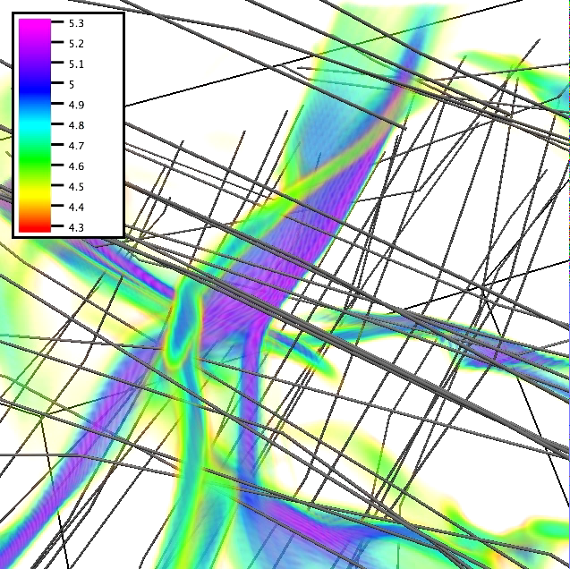
Estimated Mass of Core
6 cores are formed in the fiducial model.
238, 59, 5.3, 3.6, 2.7, 1.0 M_{sun}
238 M_{sun}
z [ pc ]
Closeup view of the
most massive core
y [ pc ]
Large effective Jeans mass is due to strong magnetic field (and turbulence).
|B| = 300 μG,
Δv = 1 km/s
→ Large mass accretion rate:
dM/dt = 4 × 10⁻³ M_{sun}/yr for 238 M_{sun} core
= 5 × 10⁻⁴ M_{sun}/yr for 59 M_{sun} core

Slide 11
Influence of Initial Parameters
Influence of initial parameters on core mass.
Average postshock state:
Effective Jeans mass:
Clearly 〈f₁〉 and 〈f 〉_{core} are different, but we can discuss qualitative influence of initial parameters on core mass by substituting 〈f₁〉 to 〈f 〉_{core}.
Core mass is expected to be increasing function of B₀ and v_{coll} ,
and decreasing function of ρ₀.

Slide 12
Influence of Initial B Strength
Core mass is indeed increasing function of B₀ and v_{coll} ,
and decreasing function of ρ₀ , as expected.
Fiducial Model
M = 238 M_{sun}
M = 64 M_{sun}
reduced B₀ → smaller M_{core}
B₀ = 20 μG
ρ₀ = 300 cm⁻³
v_{coll} = 10 km/s
B₀ = 5 μG
ρ₀ = 300 cm⁻³
v_{coll} = 10 km/s
Reduced v_{coll} → smaller M_{core}
Increased ρ₀ → smaller M_{core}
M = 107 M_{sun}
M = 17 M_{sun}
B₀ = 20 μG
ρ₀ = 3000 cm⁻³
v_{coll} = 10 km/s
B₀ = 20 μG
ρ₀ = 300 cm⁻³
v_{coll} = 5 km/s
These dependency can be used to confirm cloud-cloud collision scenario.

Slide 13
Summary
Formation of massive molecular cloud core is studied by using 3D MHD simulation
with self-gravity.
We found that
Shock compression of inhomogeneous cloud generates dense filaments perpendicular to B field.
Owing to the strong B field (and turbulence), effective Jeans mass of filaments can be huge (M_{core} > 100 M_{sun} depending on parameters).
Smaller initial B field tend to reduce core mass by enhancing density.
Smaller collision velocity tend to reduce core mass by weakening B strength.
Larger density leads to smaller core mass and faster formation timescale.
Cloud-cloud collision is a plausible mechanism of massive star (core) formation.

